Slide 2
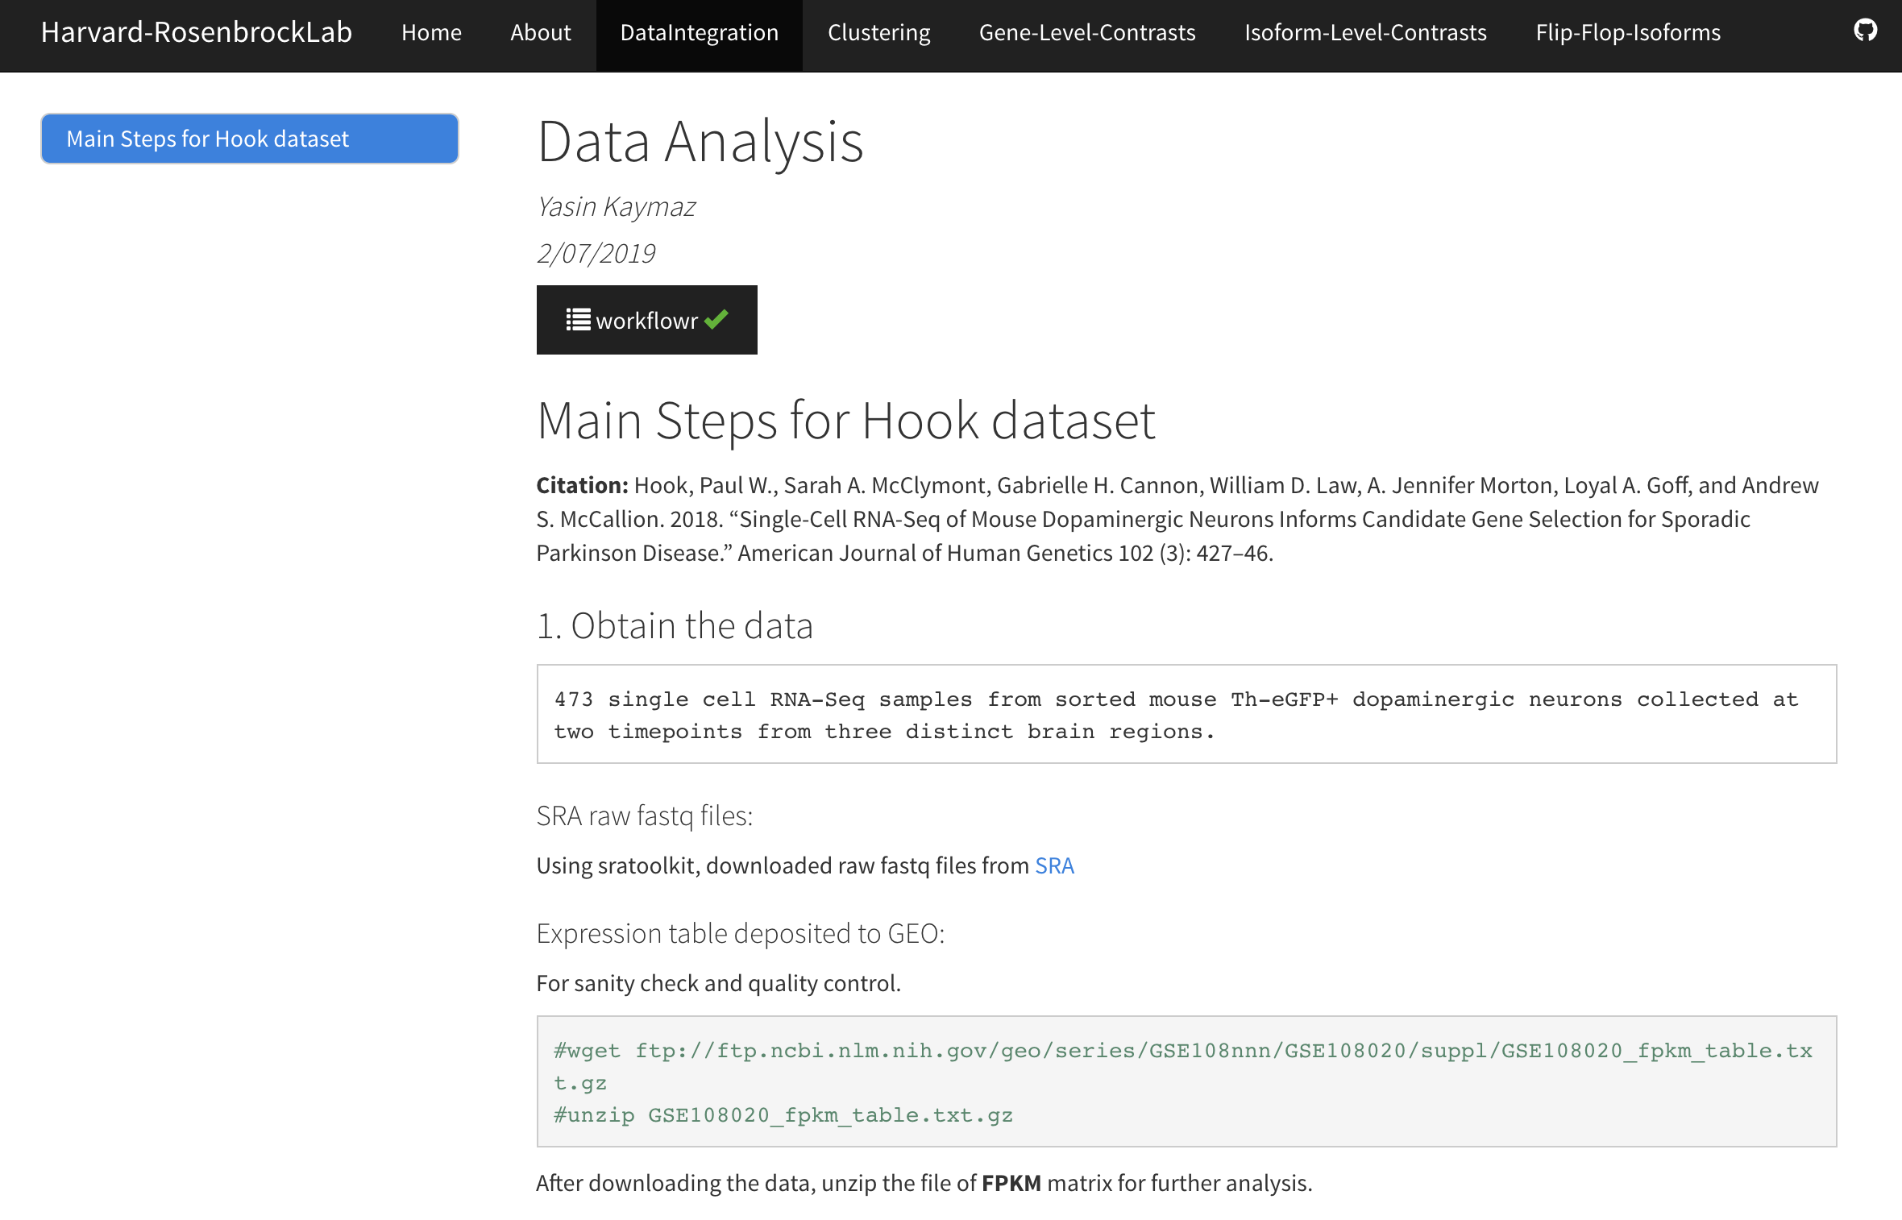
https://yasinkaymaz.github.io/Harvard-RosenbrockLab/index.html

Slide 3
Human.ID | Transcript ID | Mouse.ID | Transcript ID | Biotype
GRIA1-201 | ENST00000285900.9 | Gria1-202 | ENSMUST00000094179.10 | hGluA1o Flop
GRIA1-202 | ENST00000340592.9 | Gria1-201 | ENSMUST00000036315.15 | hGluA1i Flip
GRIA2-201 | ENST00000264426.13 | Gria2-201 | ENSMUST00000075316.9 | hGluA2o Flop
GRIA2-202 | ENST00000296526.11 | Gria-202 | ENSMUST00000107745.7 | hGluA2i Q/R Mut Flip
GRIA3-209 | ENST00000622768.4 | Gria3-209 | ENSMUST00000165288.1 | hGluA3o Flop
GRIA3-207 | ENST00000620443.1 | Gria3-201 | ENSMUST00000076349.11 | hGluA3i Flip
GRIA4-203 | ENST00000393127.6 | Gria4-201 | ENSMUST00000027020.12 | hGluA4o Flop
GRIA4-201 | ENST00000282499.9 | Gria4-202 | ENSMUST00000063508.14 | hGluA4i Flip

Slide 4
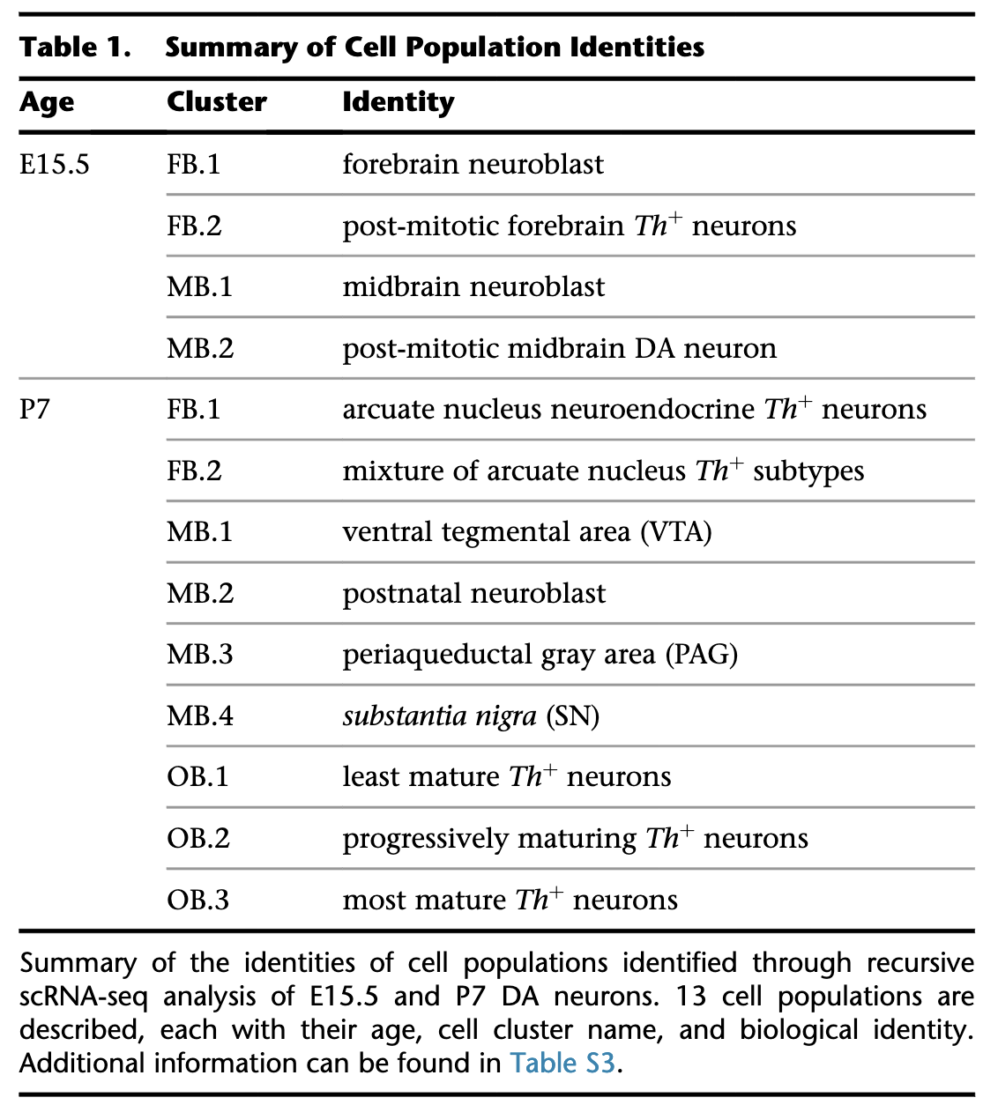
In the analysis, I excluded E15.5 cells as requested by CNSDR and kept only P7 mice cells (224 cells).

Slide 5
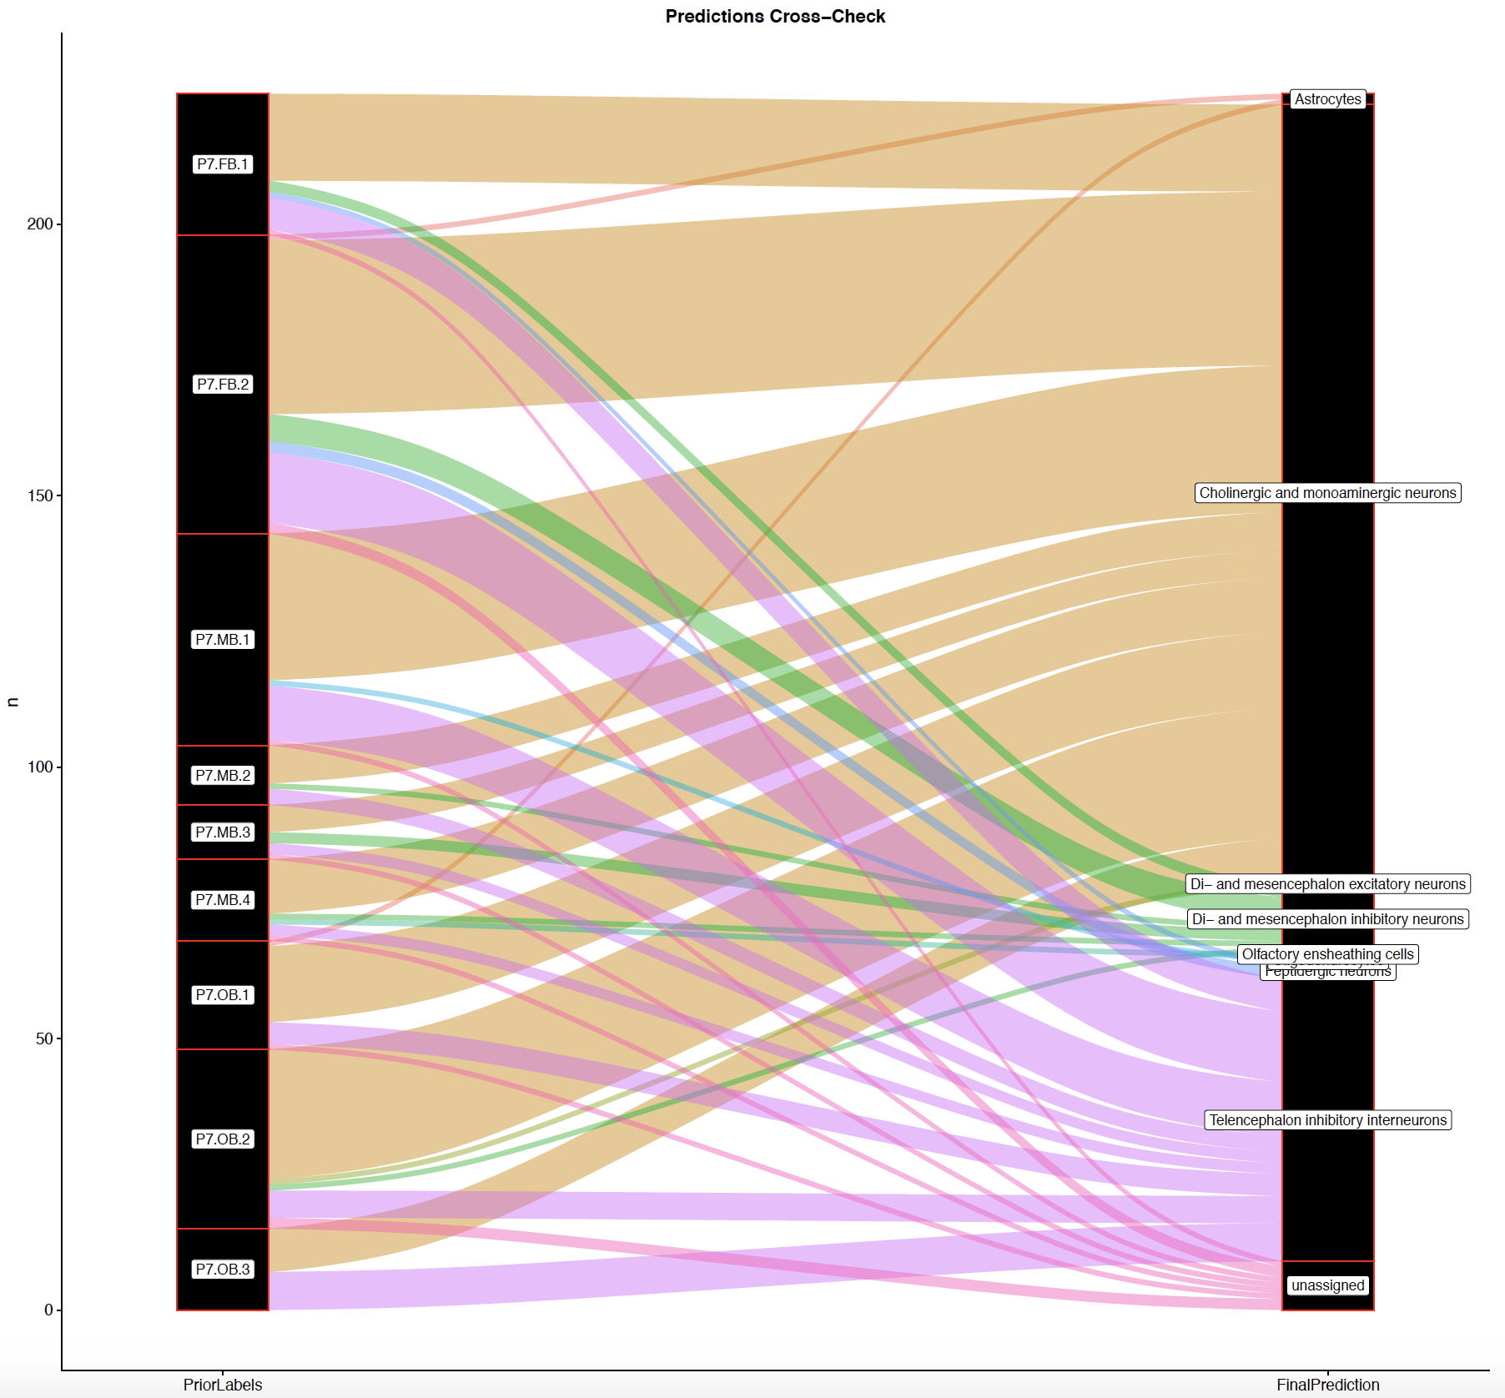
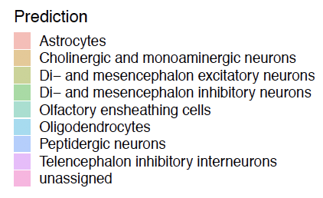
Cell types projection from KI-superset (Zeisel et al 2018, Taxonomy Rank 4)
Using scmap:
https://www.nature.com/articles/nmeth.4644

Slide 6
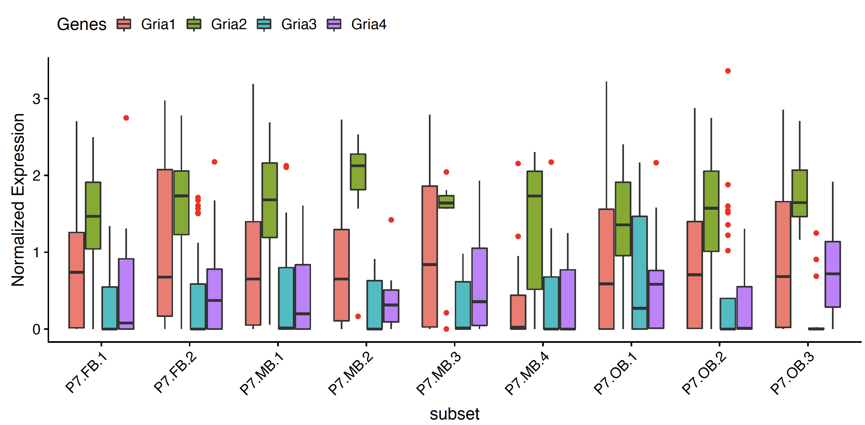
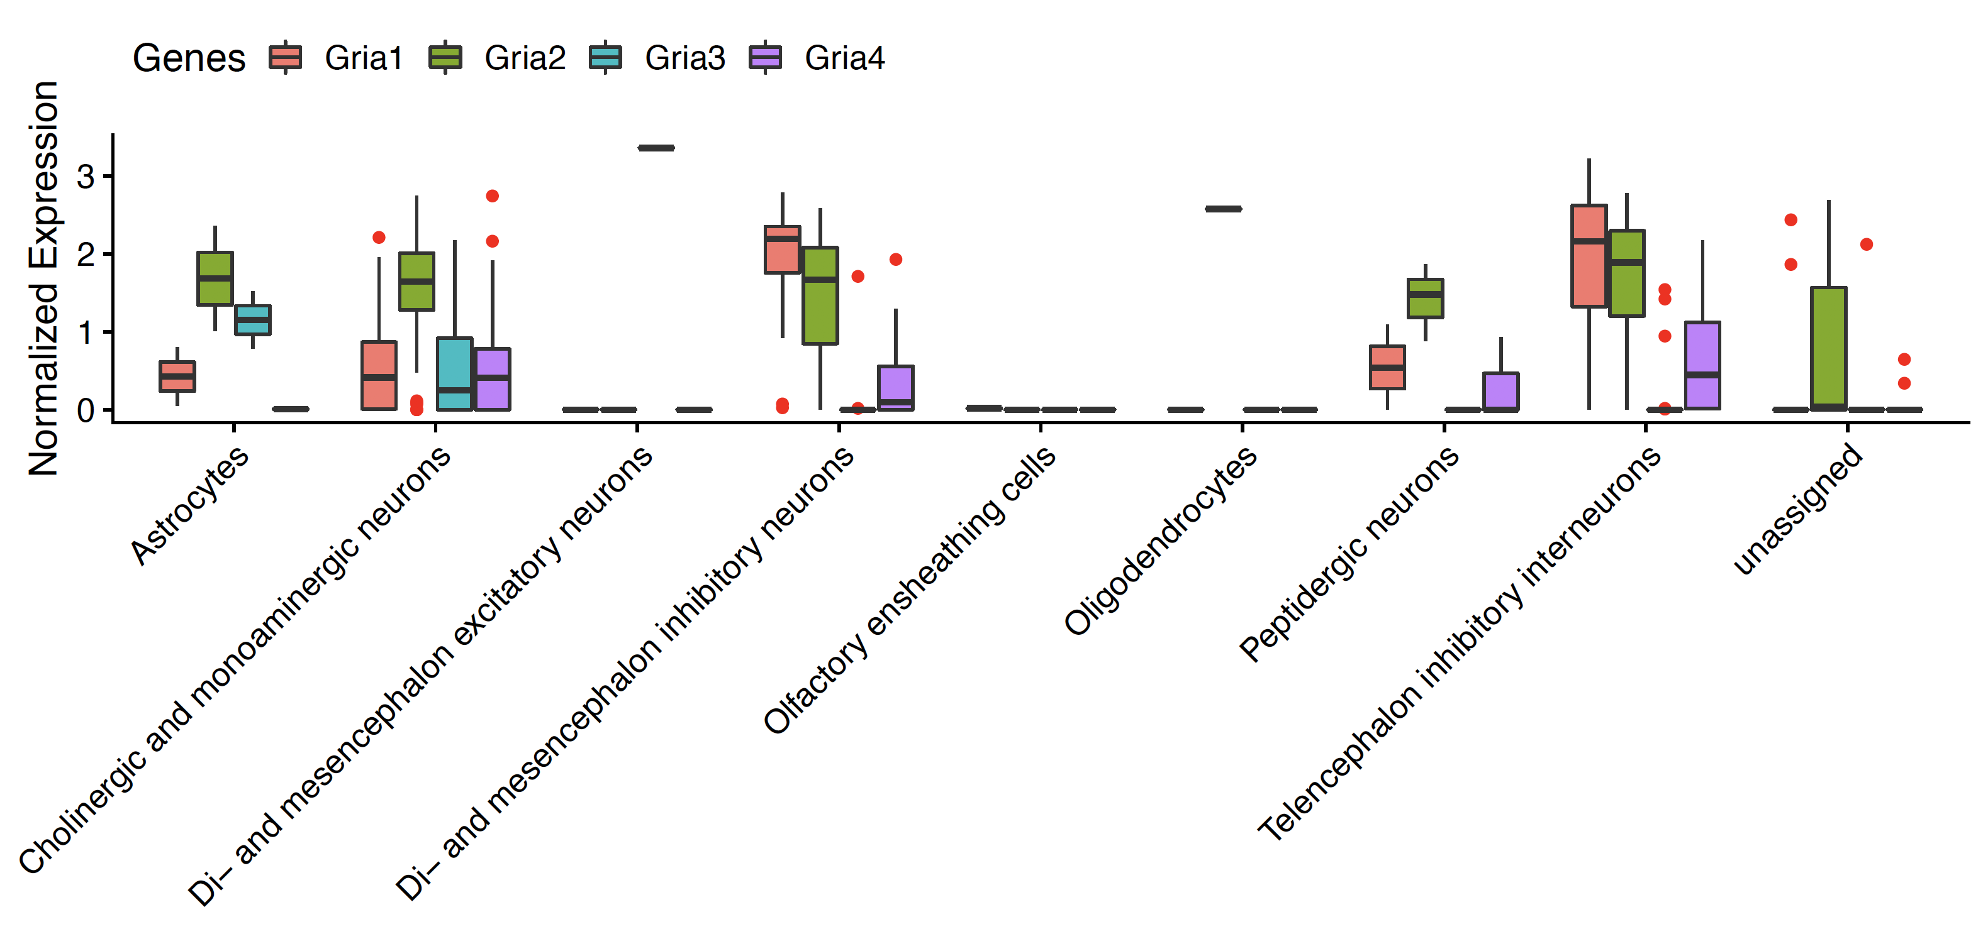
Gene level expression
These figures show the distribution of normalized expression (log2) of each glutamate ionotropic receptor AMPA genes in each cell group identified by Hook et al (upper) and cell type annotations with KI-superset (right).
The horizontal lines in bars = Median, Red dots = outlier cells.

Slide 7
Gria1 Isoform level expression

Slide 8
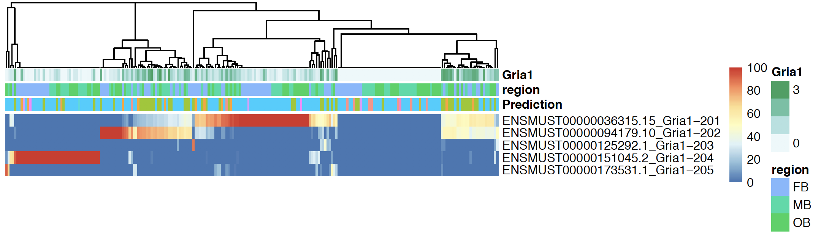
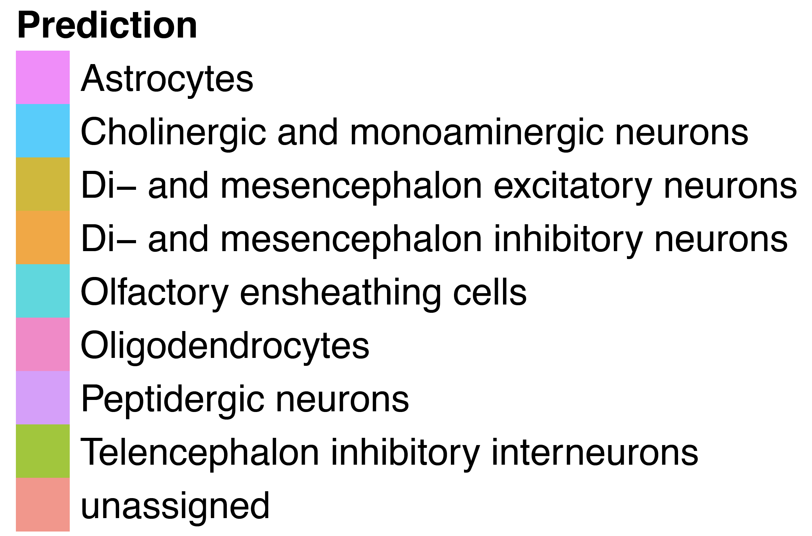
Gria1 Isoform level expression

Slide 9
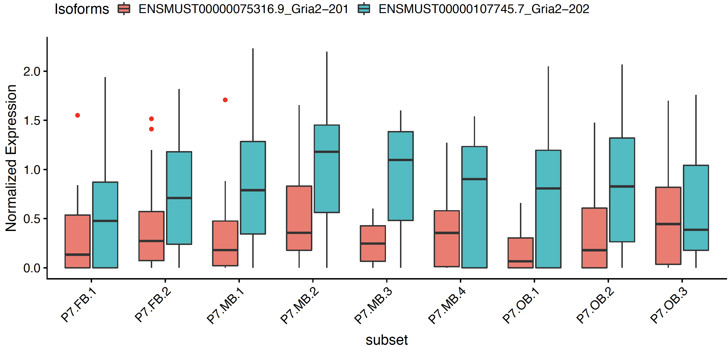
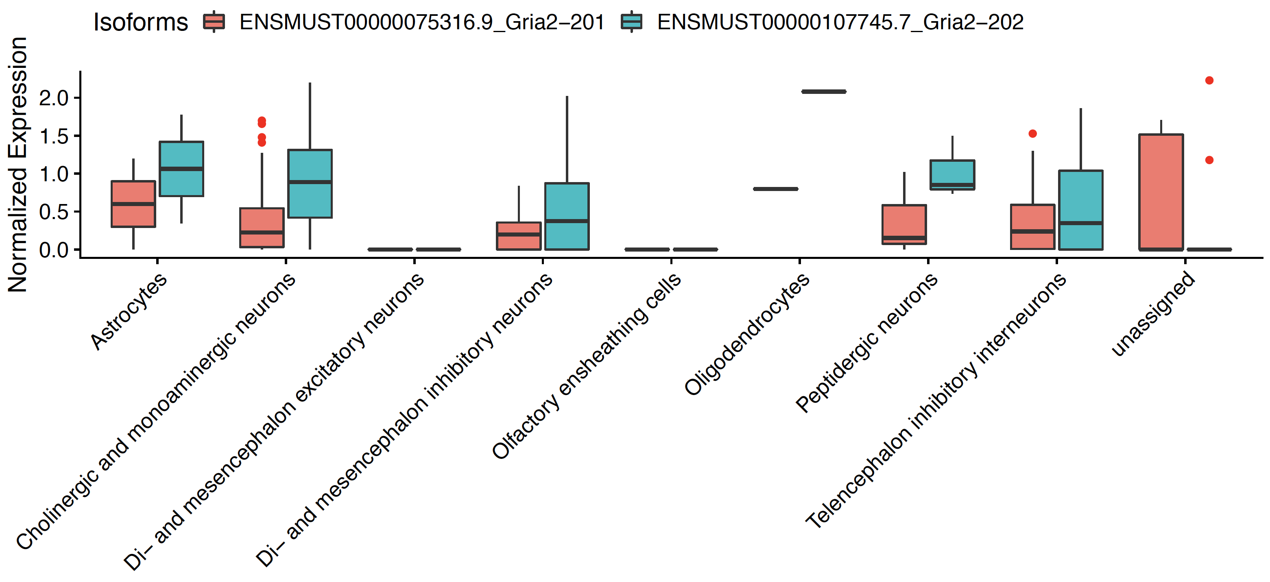
Gria2 Isoform level expression

Slide 10
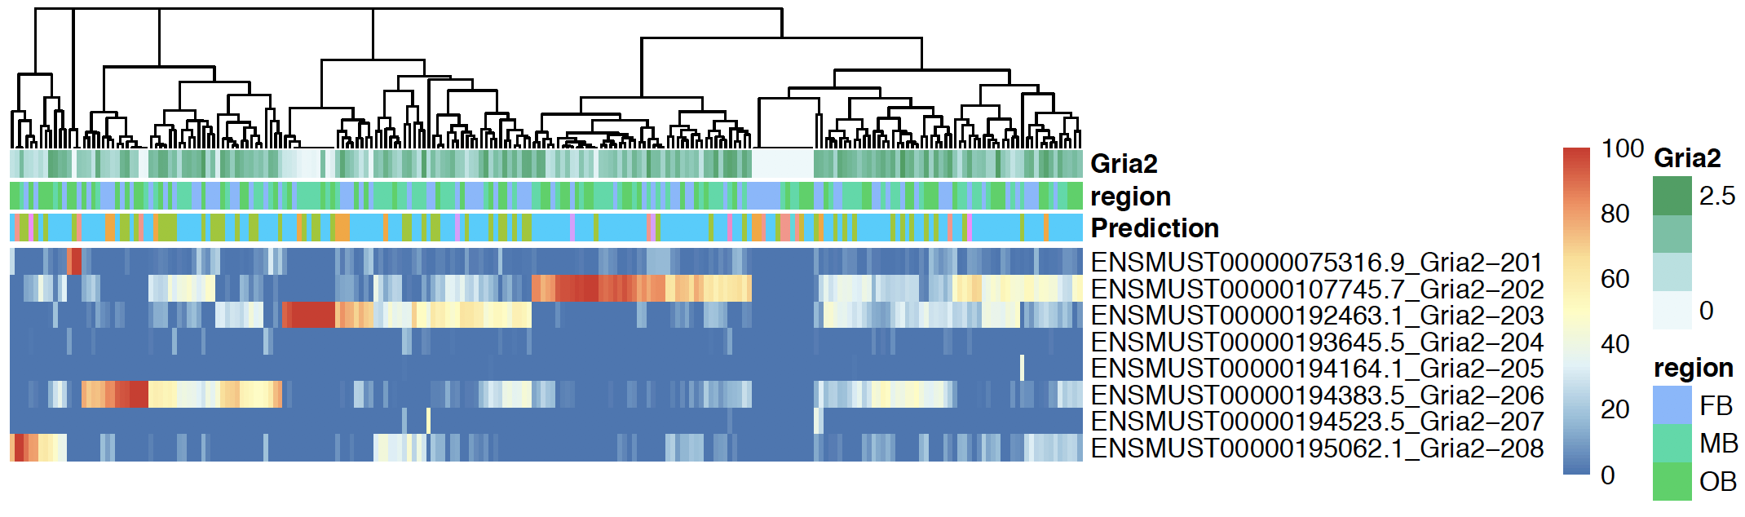
Gria2 Isoform level expression

Slide 11
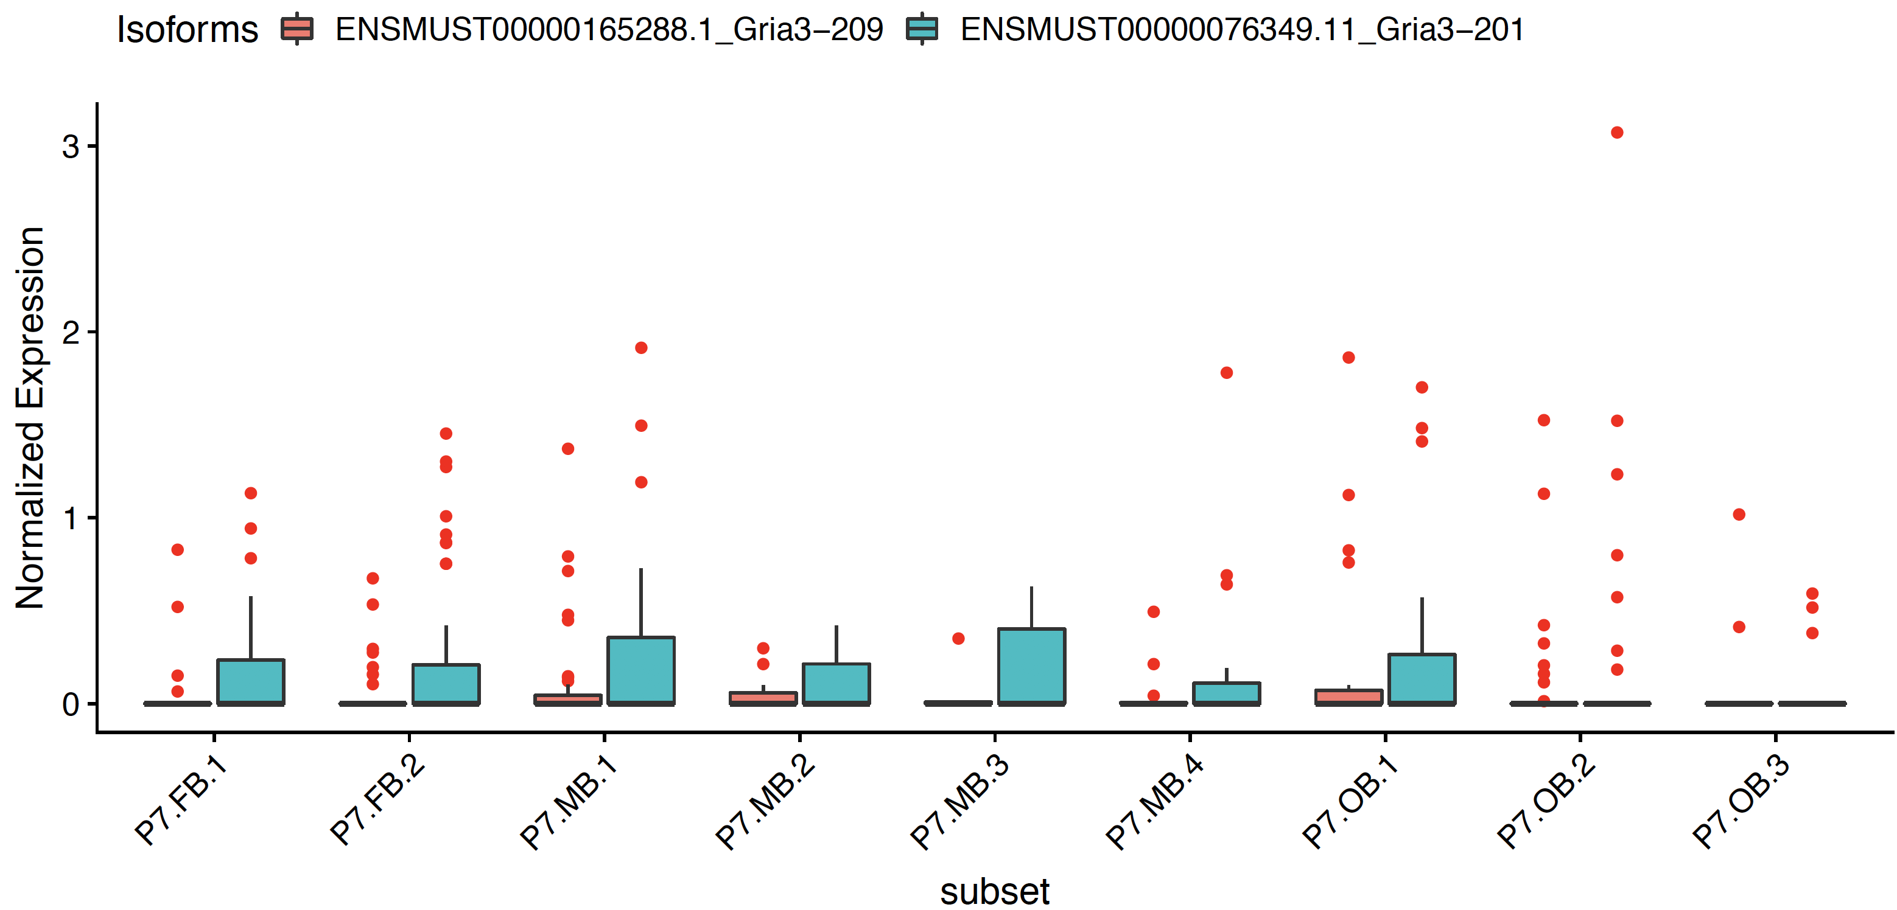
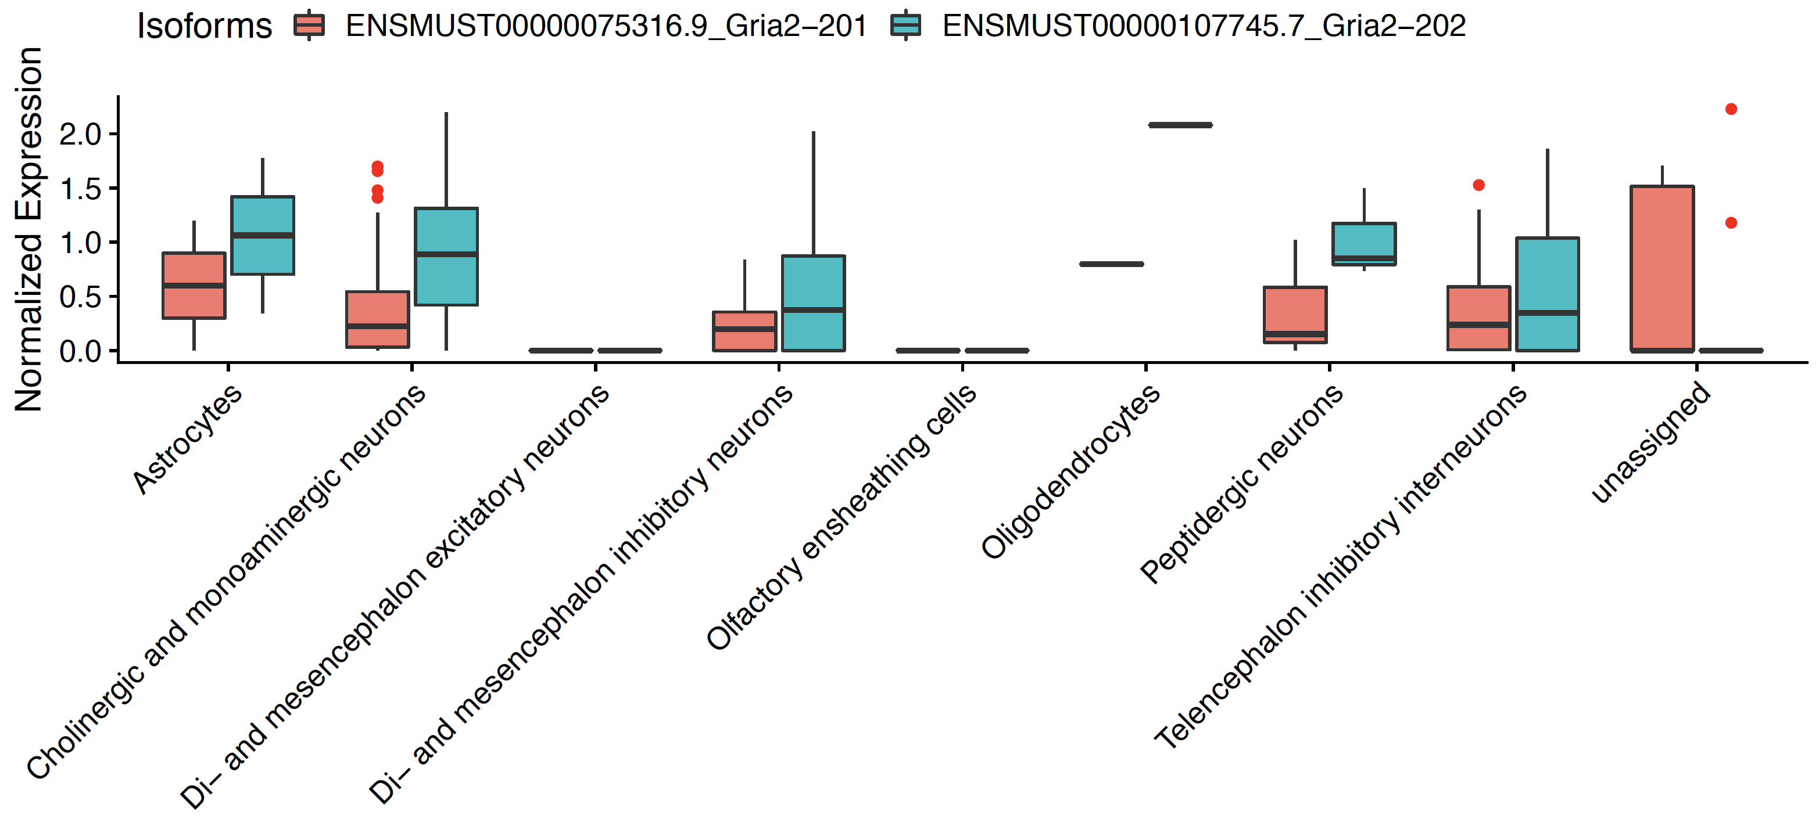
Gria3 Isoform level expression

Slide 12
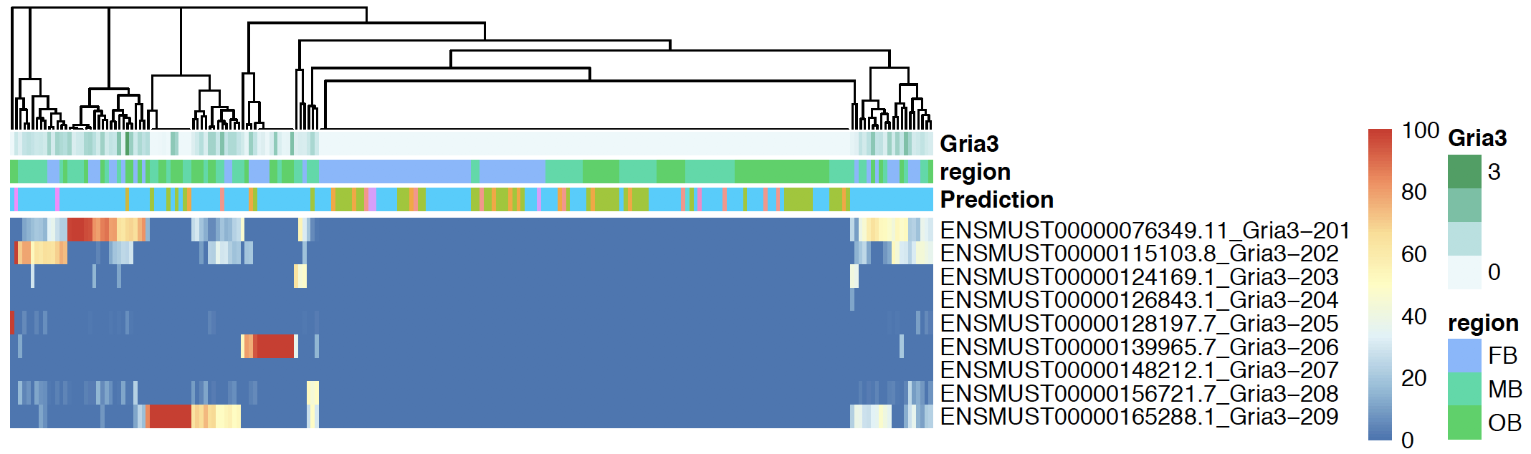
Gria3 Isoform level expression

Slide 13
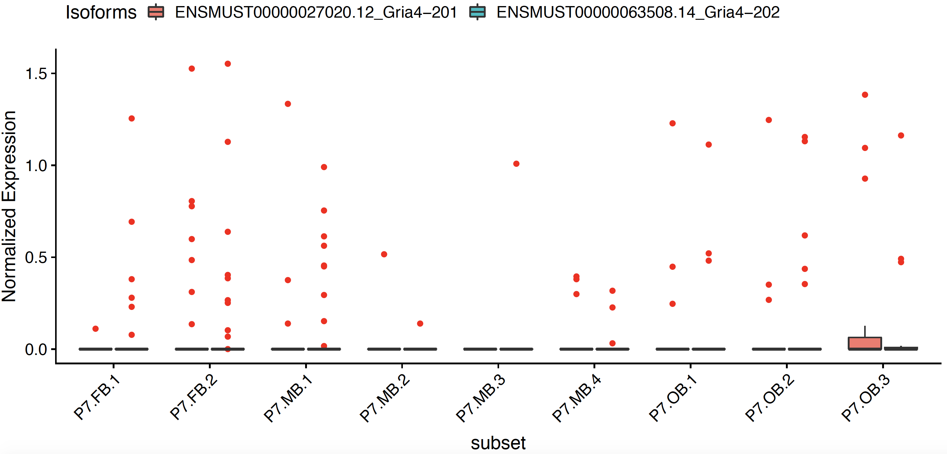
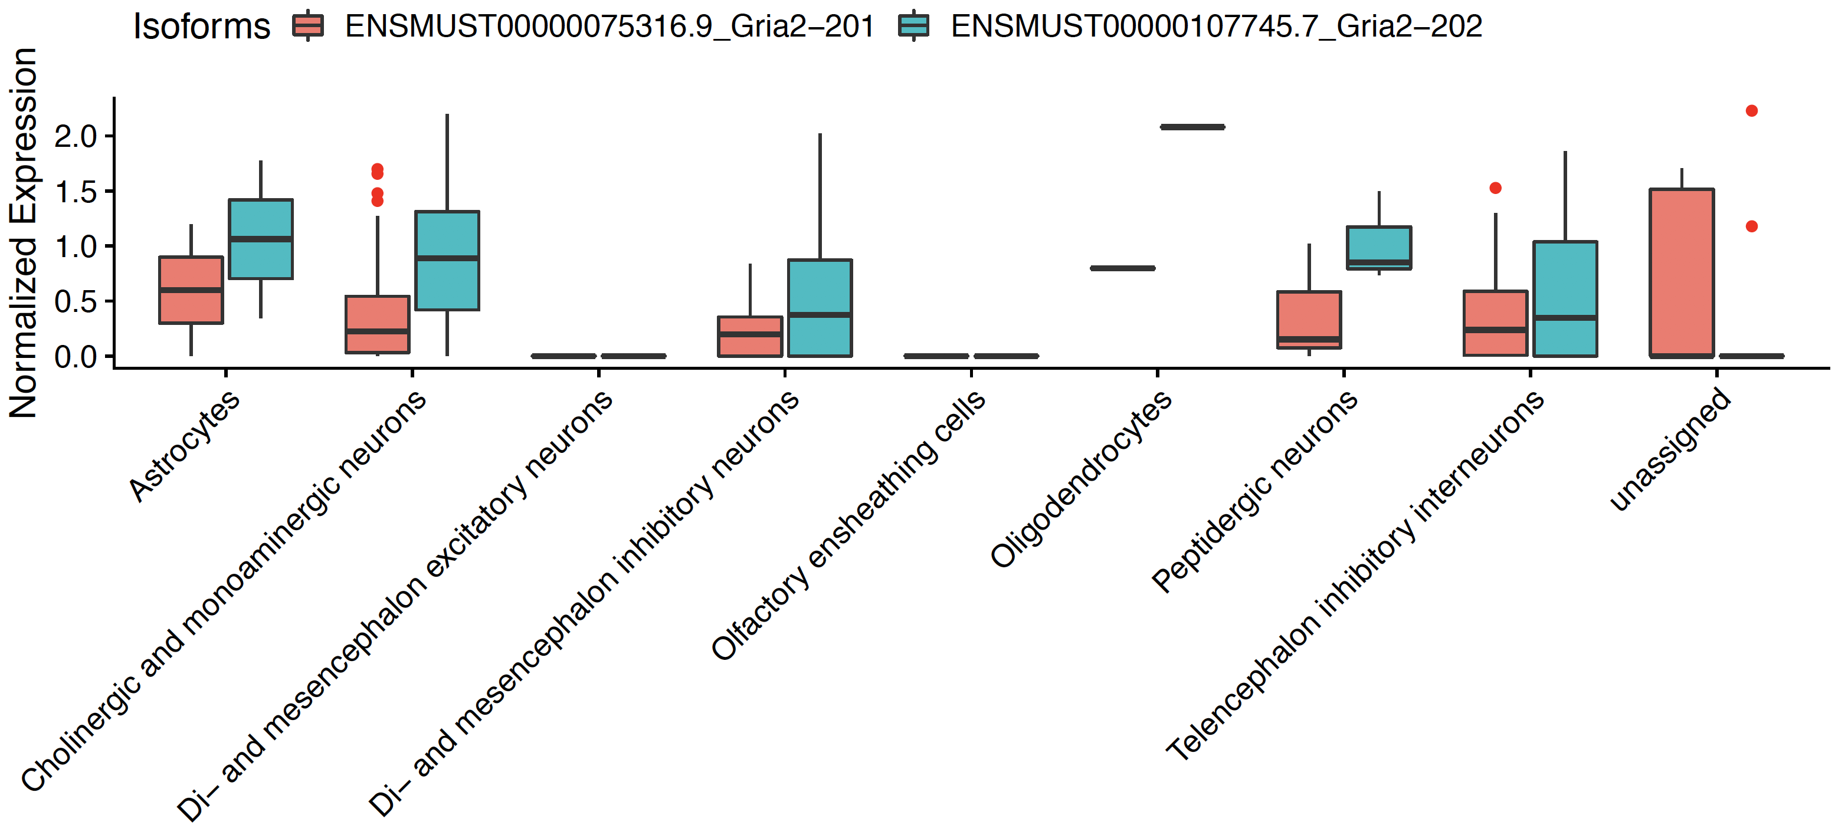
Gria4 Isoform level expression

Slide 14
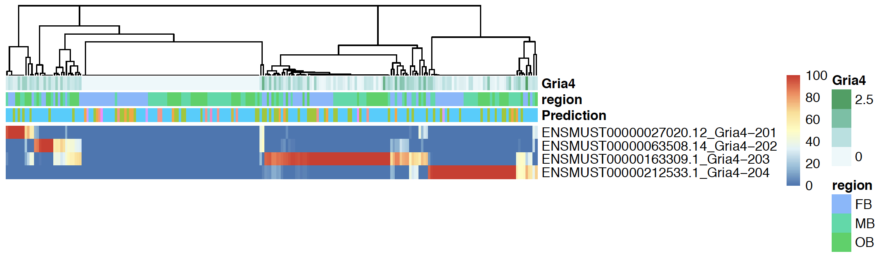
Gria4 Isoform level expression

Slide 15
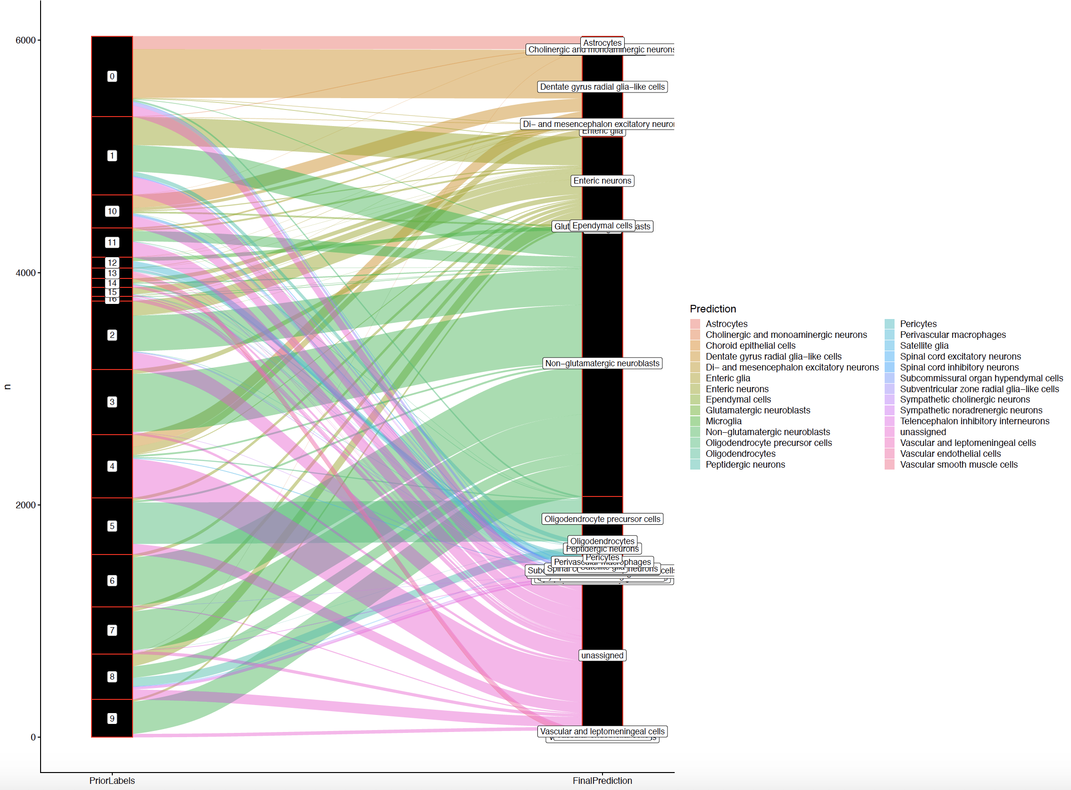
Gupta et al 2018
Cell types projection from KI-superset (Zeisel et al 2018, Taxonomy Rank 4)

